Slide 1
CPR E 281: Digital Logic
Md Maruf Ahamed
Office: 307 Durham Center
Phone: (515) 294-6323
Email: maruf@iastate.edu

Slide 2
Administrative Stuff
  Homework: HW #03 due on Sunday @ 11:59 PM
  Quiz: Quiz #3 due on Friday @ 4:25 PM
  Recitation: Recitation #03 this week
  Lab: Lab # 03 this week
      Submit pre-lab prior to the lab otherwise you will lose 20% points
  Lecture-10 Readings: Section 2.12, 2.13
  Verilog part 2: Posted on Canvas under lec 8
  Midterm 1: Friday, Feb 18

Slide 3
09–Karnaugh Maps
  Karnaugh Map (K-map)
    Two-Variable K-map
    Three-Variable K-Map
    Four-Variable K-Map
    Five-Variable K-Map
  Gray Code

Slide 4
Karnaugh Maps
Readings-2.11

Slide 5
Motivation
We made use of the rules, theorems, and properties of Boolean algebra to find a reduced-cost implementation of a function in either sum-of-products or product-of-sums form.
In general, it is not obvious when to apply these theorems and properties to find a minimum-cost circuit, and it is often
tedious and impractical to do so.
How do we guarantee we have reached the minimum SOP/POS representation?
This section introduces a more manageable approach, call the Karnaugh map, which provides a systematic way of producing a minimum-cost logic expression

Slide 6
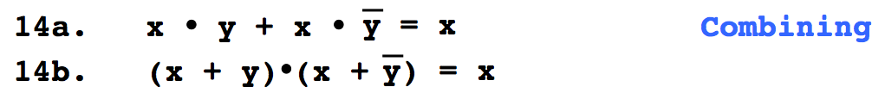

Do You Still Remember This
Boolean Algebra Theorem?

Slide 7
Two-Variable K-Map

Slide 8
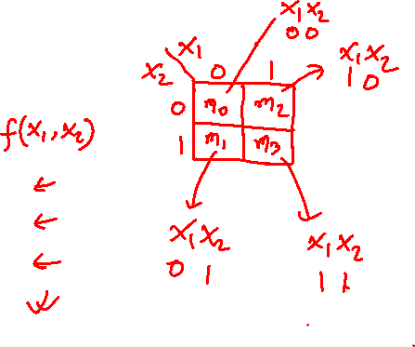
Karnaugh Map (K-map)
View the function in a visual form. The map consists of cells that correspond to the rows of the truth table. Each of the rows is identified by a minterm.
Two variable K-Map
  It has four cells.
  The columns of the map are labeled by the value of x₁, and the rows are labeled by x₂.
  This labeling leads to the location of minterms
x
1
x
2
0
0
m
0
0
1
m
1
1
0
m
2
1
1
m
3
(a) Truth table

Slide 9
Karnaugh Map (K-map)
View the function in a visual form. The map consists of cells that correspond to the rows of the truth table. Each of the rows is identified by a minterm.
Two variable K-Map
  It has four cells.
  The columns of the map are labeled by the value of x₁, and the rows are labeled by x₂.
  This labeling leads to the location of minterms
x
1
x
2
x
x
1
0
0
m
2
0
1
0
0
1
m
1
0
m
0
m
2
1
0
m
2
1
m
1
m
3
1
1
m
3
(a) Truth table
(b) Karnaugh map
[ Figure 2.49 from the textbook ]

Slide 10

Minterms
x
1
x
2
x
x
m
m
m
m
1
2
0
1
2
3
0
0
m
0
0
0
1
0
0
0
0
1
m
1
0
1
0
1
0
0
1
0
m
2
1
0
0
0
1
0
1
1
m
3
1
1
0
0
0
1

Slide 11
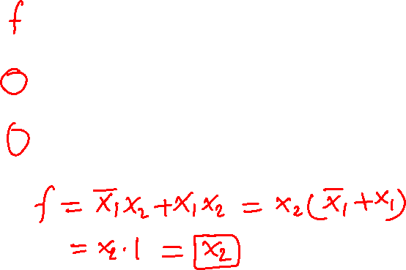
Minterm Example
x
1
x
2
x
x
m
m
m
m
m
+ m
1
2
0
1
2
3
1
3
0
0
0
0
0
1
0
0
0
0
0
1
1
0
1
0
1
0
0
1
1
0
0
1
0
0
0
1
0
0
1
1
1
1
1
0
0
0
1
1

Slide 12
Minterm Example
x
1
x
2
x
x
m
m
m
m
m
+ m
1
2
0
1
2
3
1
3
0
0
0
0
0
1
0
0
0
0
0
1
1
0
1
0
1
0
0
1
1
0
0
1
0
0
0
1
0
0
1
1
1
1
1
0
0
0
1
1
_
x₁x₂ + x₁x₂ = x₂

Slide 13
Grouping Example
x
1
x
1
x
2
x
2
x
x
0
1
0
1
1
2
0
0
0
m
0
0
0
0
0
0
0
0
1
1
m
1
1
1
0
1
0
1
1
0
0
m
2
1
1
1
m
3
m₁
m₃
x
1
x
2
0
1
0
m
0
m
2
1
m
1
m
3

Slide 14
Grouping Example
x
1
x
1
x
1
x
2
x
2
x
2
0
1
0
1
0
1
0
0
0
0
0
0
0
0
0
+
=
1
1
0
1
0
1
1
1
1
m₁
+
m₃
=
m₁ + m₃
x
1
x
2
0
0
0
m
0
0
1
1
m
1
1
0
0
m
2
1
1
1
m
3

Slide 15
Grouping Example
x
1
x
1
x
1
x
2
x
2
x
2
0
1
0
1
0
1
0
0
0
0
0
0
0
0
0
+
=
1
1
0
1
0
1
1
1
1
m₁
+
m₃
=
m₁ + m₃
x
1
x
2
0
0
0
m
0
0
1
1
m
1
1
0
0
m
2
1
1
1
m
3

Slide 16
Grouping Example
Minterms in any two cells that are adjacent, either in the same row or the same column, can be combined.
x
1
x
1
x
1
x
2
x
2
x
2
0
1
0
1
0
1
0
0
0
0
0
0
0
0
0
+
=
1
1
0
1
0
1
1
1
1
m₁
+
m₃
=
m₁ + m₃
_
x₁x₂
+
x₁x₂
=
x₂
Property 14a (Combining)

Slide 17
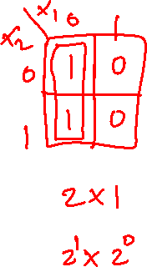
Grouping Rules
Group “1”s with rectangles
Both sides a power of 2:
  1x1, 1x2, 2x1, 2x2, 1x4, 4x1, 2x4, 4x2, 4x4
Can use the same minterm more than once
Can wrap around the edges of the map
Some rules in selecting groups:
  Try to use as few groups as possible to cover all “1”s.
  For each group, try to make it as large as you can (i.e., if you can use a 2x2, don’t use a 2x1 even if that is enough).

Slide 18
Two-Variable K-map
x
1
x
2
x
x
1
2
0
1
0
0
m
0
0
1
m
0
m
0
m
2
1
1
0
m
2
1
m
1
m
3
1
1
m
3
(a) Truth table
(b) Karnaugh map
[ Figure 2.49 from the textbook ]

Slide 19
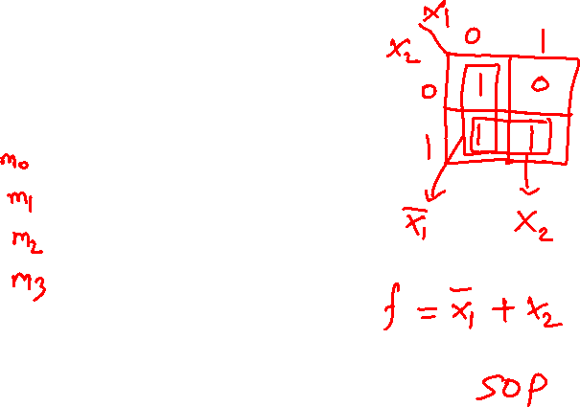
Step-By-Step Example
1. Draw The Map
x
1
x
2
f
0
0
1
2. Fill The Map
0
1
1
1
0
0
1
1
1
3. Grouping
4. Write The Expression

Slide 20
Step-By-Step Example
x
1
1. Draw The Map
x
2
0
1
x
1
x
2
f
0
m
m
0
2
0
0
1
1
m
m
0
1
1
1
3
1
0
0
x
x
1
1
1
1
2
0
1
2. Fill The Map
0
1
0
1
1
1
3. Grouping
_
x₁ + x₂
4. Write The Expression

Slide 21
1. Draw The Map
x
1
x
2
x
x
1
0
0
1
2
0
1
0
1
1
0
1
0
0
1
1
1
1

Slide 22
2. Fill The Map
x
1
x
2
x
x
x
1
x
1
m
0
0
0
1
2
0
1
2
0
1
m
1
0
1
1
0
m
m
1
0
0
2
0
m
2
1
0
0
m
1
m
m
1
1
1
3
1
1
1
1
3

Slide 23
3. Group
x
1
x
2
x
x
1
m
0
0
0
1
2
0
1
m
1
0
1
1
0
1
0
m
2
1
0
0
m
1
1
1
3
1
1
1
Group “1”s with rectangles
Both sides a power of 2:
  1x1, 1x2, 2x1, 2x2, 1x4, 4x1, 2x4, 4x2, 4x4
Can use the same minterm more than once
Can wrap around the edges of the map
Try to use as few groups as possible to cover all “1”s.
For each group, try to make it as large as you can

Slide 24
3. Group
x
1
x
2
x
x
1
m
0
0
0
1
2
0
1
m
1
0
1
1
0
1
0
m
2
1
0
0
m
1
1
1
3
1
1
1

Slide 25
3. Group
x
1
x
2
x
x
1
m
0
0
0
1
2
0
1
m
1
0
1
1
0
1
0
m
2
1
0
0
m
1
1
1
3
1
1
1

Slide 26
4. Write The Expression
Find which variable is constant
x
1
x
2
x
x
1
0
0
1
2
0
1
0
1
1
0
1
0
1
0
0
1
1
1
1
1
1
_
x₁ + x₂

Slide 27
Writing The Expression
Find which variable is constant
x
1
x
2
_
0
1
x₁ is constant
0
1
0
1
1
0

Slide 28
Writing The Expression
Find which variable is constant
x
1
x
2
0
1
x₁ is constant
0
0
1
1
0
1

Slide 29
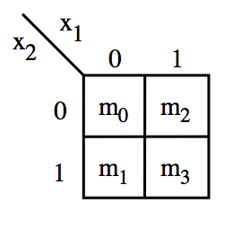
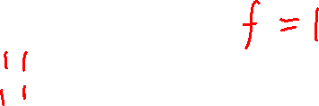
These are all valid groupings
In this case the result is the constant function 1.

Slide 30
Why are these two not valid?

Slide 31
Let’s Find Out
x
1
x
1
x
2
x
2
0
1
0
1
0
1
0
0
0
0
1
0
0
1
0
1
m₀
m₃

Slide 32
Let’s Find Out
x
1
x
1
x
1
x
2
x
2
x
2
0
1
0
1
0
1
0
1
0
0
0
0
0
1
0
+
=
1
0
0
1
0
1
1
0
1
m₀
+
m₃
=
m₀ + m₃

Slide 33
Let’s Find Out
x
1
x
1
x
1
x
2
x
2
x
2
0
1
0
1
0
1
0
1
0
0
0
0
0
1
0
+
=
1
0
0
1
0
1
1
0
1
m₀
+
m₃
=
m₀ + m₃

Slide 34

Let’s Find Out
x
1
x
1
x
1
x
2
x
2
x
2
0
1
0
1
0
1
0
1
0
0
0
0
0
1
0
+
=
1
0
0
1
0
1
1
0
1
m₀
+
m₃
=
m₀ + m₃
_
_
_
_
x₁x₂
+
x₁x₂
=
+
x₁x₂
x₁x₂
We can’t use Property 14a here. This can’t be simplified.

Slide 35
Three-Variable K-Map

Slide 36
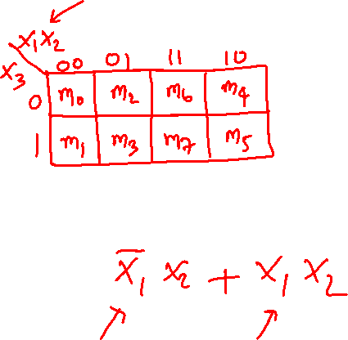
Location of three-variable minterms
[ Figure 2.51 from the textbook ]

Slide 37
Location of three-variable minterms

Slide 38
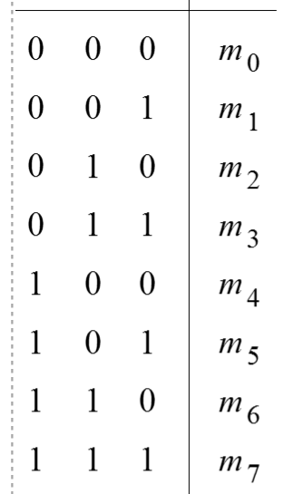
Location of three-variable minterms

Slide 39
Location of three-variable minterms
Notice the placement of
  Variables
  Binary pair values
  Minterms
To ensure that minterms in the adjacent cells in the map can always be combined into a single product term, the adjacent cells must differ in the value of only one variable.

Slide 40
Location of three-variable minterms
Notice the placement of
  Variables
  Binary pair values
  Minterms

Slide 41
Location of three-variable minterms
Notice the placement of
  Variables
  Binary pair values
  Minterms

Slide 42

Gray Code
Sequence of binary codes
Two neighboring lines vary by only 1 bit
000
001
011
010
110
111
101
100
00
01
11
10

Slide 43
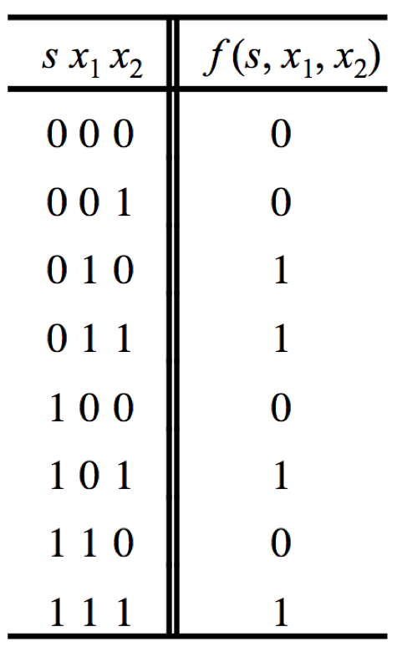

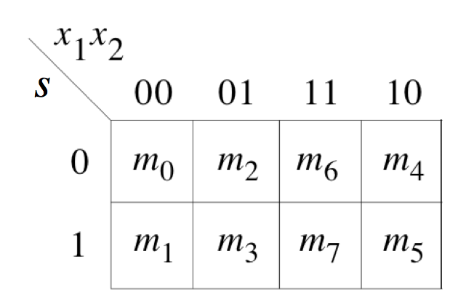
Gray Code & K-map
s x₁
x₂

Slide 44
Gray Code & K-map
s x₁
x₂
000
010
110
100
001
011
111
101

Slide 45
Gray Code & K-map
s x₁
x₂
000
010
110
100
001
011
111
101

Slide 46
Gray Code & K-map
s x₁
x₂
000
010
110
100
001
011
111
101

Slide 47
Gray Code & K-map
s x₁
x₂
000
010
110
100
001
011
111
101

Slide 48
Gray Code & K-map
s x₁
x₂
000
010
110
100
001
011
111
101

Slide 49
Gray Code & K-map
s x₁
x₂
000
010
110
100
001
011
111
101
These two neighbors
differ only in the LAST bit

Slide 50
Gray Code & K-map
s x₁
x₂
000
010
110
100
001
011
111
101
These two neighbors
differ only in the LAST bit

Slide 51
Gray Code & K-map
s x₁
x₂
000
010
110
100
001
011
111
101
These two neighbors
differ only in the FIRST bit

Slide 52
Gray Code & K-map
s x₁
x₂
000
010
110
100
001
011
111
101
These four neighbors
differ in the FIRST and LAST bit
They are similar in their MIDDLE bit

Slide 53

Adjacency Rules
adjacent
columns

Slide 54
Gray Code & K-map
s x₁
x₂
000
010
110
100
001
011
111
101
These two neighbors
differ only in the FIRST bit

Slide 55
Gray Code & K-map
s x₁
x₂
000
010
110
100
001
011
111
101
These four neighbors
differ in the FIRST and LAST bit
They are similar in their MIDDLE bit

Slide 56
Adjacency Rules
As if the K-map were
drawn on a cylinder
adjacent
columns

Slide 57
Adjacency Rules
m₄
m₀
m₂
m₅
m₁
m₃
As if the K-map were
drawn on a cylinder
adjacent
columns

Slide 58
These are valid groupings

Slide 59
These are valid groupings

Slide 60
These are valid groupings

Slide 61
These are valid groupings

Slide 62
These are valid groupings

Slide 63

This is a valid grouping

Slide 64

Some invalid groupings

Slide 65
Example 1: three-variable Karnaugh maps
Find the simplest SOP form of the following functions using a K-map:
f(x1, x2, x3) = Σ m(1, 4, 5, 6)
Or
f(x1, x2, x3) = Π M(0, 2, 3, 7)
[ Figure 2.52a from the textbook ]

Slide 66
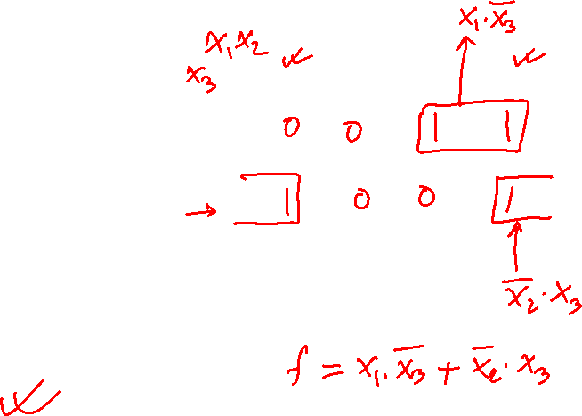
Example 1: three-variable Karnaugh maps
Find the simplest SOP form of the following functions using a K-map:
f(x1, x2, x3) = Σ m(1, 4, 5, 6)
Or
f(x1, x2, x3) = Π M(0, 2, 3, 7)
00 01 11 10
0
1
[ Figure 2.52a from the textbook ]

Slide 67
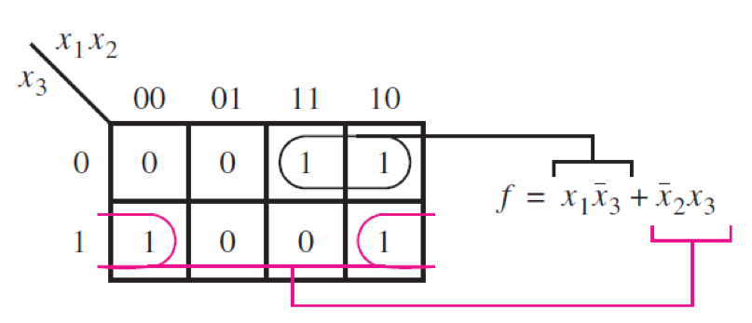
Example 1: three-variable Karnaugh maps
Find the simplest SOP form of the following functions using a K-map:
f(x1, x2, x3) = Σ m(1, 4, 5, 6)
Or
f(x1, x2, x3) = Π M(0, 2, 3, 7)
[ Figure 2.52a from the textbook ]

Slide 68
Example 2: three-variable Karnaugh maps
Find the simplest SOP form of the following functions using a K-map:
f(x1, x2, x3) = Σ m(0, 2, 4, 5, 6)
Or
f(x1, x2, x3) = Π M(1, 3, 7)
[ Figure 2.52a from the textbook ]

Slide 69
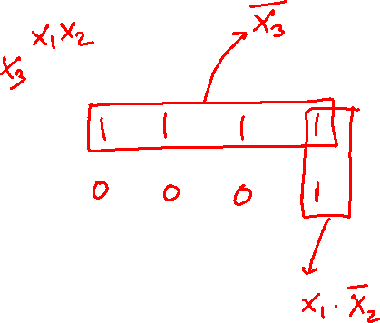
Example 2: three-variable Karnaugh maps
Find the simplest SOP form of the following functions using a K-map:
f(x1, x2, x3) = Σ m(0, 2, 4, 5, 6)
Or
f(x1, x2, x3) = Π M(1, 3, 7)
00 01 11 10
0
1
[ Figure 2.52a from the textbook ]

Slide 70
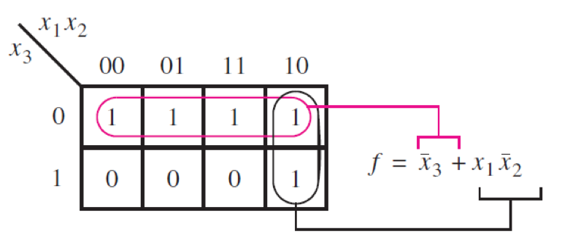
Example 2: three-variable Karnaugh maps
Find the simplest SOP form of the following functions using a K-map:
f(x1, x2, x3) = Σ m(0, 2, 4, 5, 6)
Or
f(x1, x2, x3) = Π M(1, 3, 7)
[ Figure 2.52b from the textbook ]

Slide 71
Example 3: three-variable Karnaugh maps
Find the simplest SOP form of the following functions using a K-map:
f(y0, y1, y2) = Σ m(0, 1, 4, 6, 7)
Or
f(y0, y1, y2) = Π M(2, 3, 5)
[ Figure 2.52a from the textbook ]

Slide 72
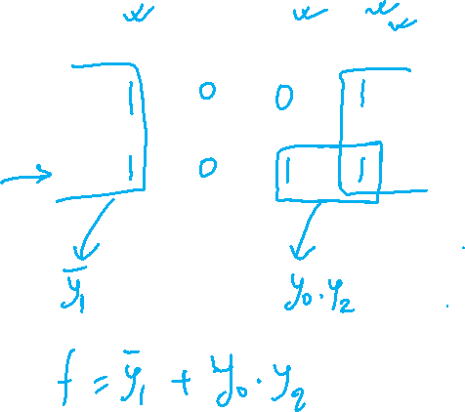
Example 3: three-variable Karnaugh maps
Find the simplest SOP form of the following functions using a K-map:
f(y0, y1, y2) = Σ m(0, 1, 4, 5, 7)
Or
f(y0, y1, y2) = Π M(2, 3, 6)
y₀ y₁
y₂
00 01 11 10
0
1
[ Figure 2.52a from the textbook ]

Slide 73
Four-Variable K-Map

Slide 74
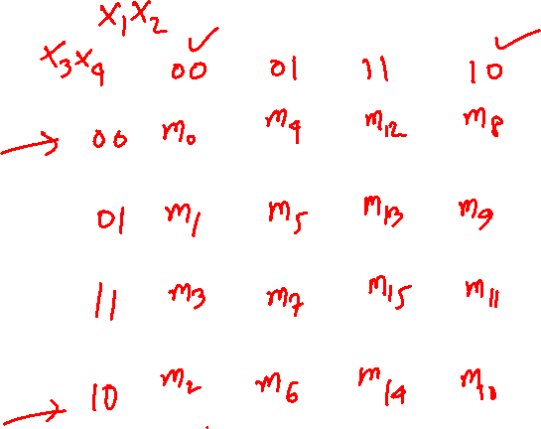
A four-variable Karnaugh map
x1 | x2 | x3 | x4
0 | 0 | 0 | 0 | m0
0 | 0 | 0 | 1 | m1
0 | 0 | 1 | 0 | m2
0 | 0 | 1 | 1 | m3
0 | 1 | 0 | 0 | m4
0 | 1 | 0 | 1 | m5
0 | 1 | 1 | 0 | m6
0 | 1 | 1 | 1 | m7
1 | 0 | 0 | 0 | m8
1 | 0 | 0 | 1 | m9
1 | 0 | 1 | 0 | m10
1 | 0 | 1 | 1 | m11
1 | 1 | 0 | 0 | m12
1 | 1 | 0 | 1 | m13
1 | 1 | 1 | 0 | m14
1 | 1 | 1 | 1 | m15
[ Figure 2.53 from the textbook ]

Slide 75
A four-variable Karnaugh map
x1 | x2 | x3 | x4
0 | 0 | 0 | 0 | m0
0 | 0 | 0 | 1 | m1
0 | 0 | 1 | 0 | m2
0 | 0 | 1 | 1 | m3
0 | 1 | 0 | 0 | m4
0 | 1 | 0 | 1 | m5
0 | 1 | 1 | 0 | m6
0 | 1 | 1 | 1 | m7
1 | 0 | 0 | 0 | m8
1 | 0 | 0 | 1 | m9
1 | 0 | 1 | 0 | m10
1 | 0 | 1 | 1 | m11
1 | 1 | 0 | 0 | m12
1 | 1 | 0 | 1 | m13
1 | 1 | 1 | 0 | m14
1 | 1 | 1 | 1 | m15
[ Figure 2.53 from the textbook ]

Slide 76
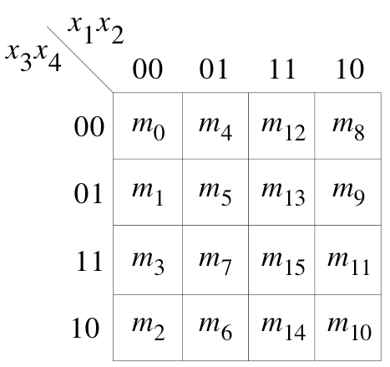
Adjacency Rules
adjacent
rows
adjacent
columns
adjacent
columns

Slide 77
Adjacency Rules
adjacent
rows
As if the K-map were
drawn on a torus
adjacent
columns

Slide 78
Adjacency Rules
m₈
m₁₀
m₀
m₂
m₁₄
m₁₂
adjacent
rows
m₆
m₄
As if the K-map were
drawn on a torus
adjacent
columns

Slide 79
Some Valid Groupings

Slide 80
Some Valid Groupings

Slide 81
Some Valid Groupings

Slide 82
Some Valid Groupings

Slide 83
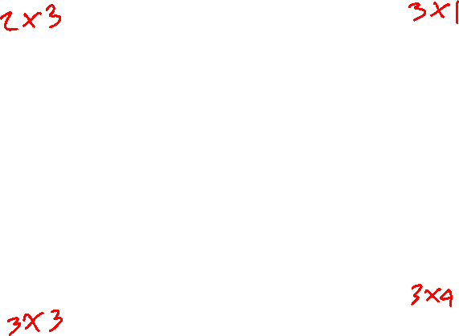
Some Invalid Groupings
All sides must be powers of 2.

Slide 84
Some valid Groupings
All sides must be powers of 2.

Slide 85
Example 4: four-variable Karnaugh map
Find the simplest SOP form of the following functions using a K-map:
f(x1, x2, x3, x4) = Σ m(2, 3, 9, 10, 11, 13)
Or
f(x1, x2, x3, x4) = Π M(1, 3, 7)
[ Figure 2.54 from the textbook ]

Slide 86
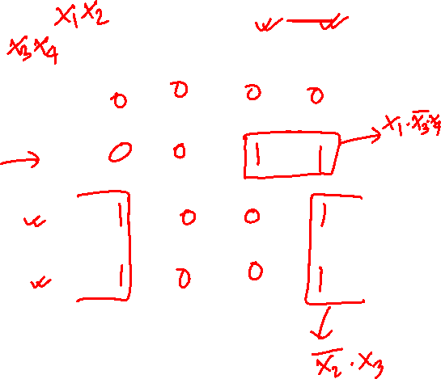
Example 4: four-variable Karnaugh map
Find the simplest SOP form of the following functions using a K-map:
f(x1, x2, x3, x4) = Σ m(2, 3, 9, 10, 11, 13)
00 01 11 10
00
01
11
10
[ Figure 2.54 from the textbook ]

Slide 87
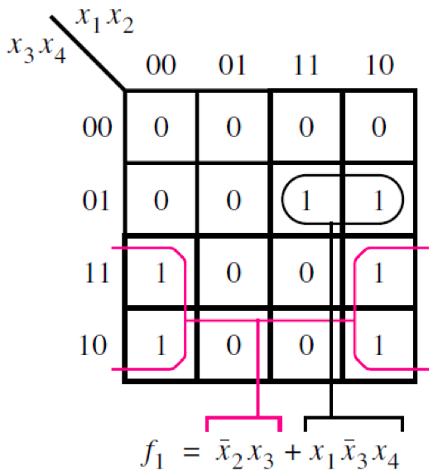
Example 4: four-variable Karnaugh map
Find the simplest SOP form of the following functions using a K-map:
f(x1, x2, x3, x4) = Σ m(2, 3, 9, 10, 11, 13)
[ Figure 2.54 from the textbook ]

Slide 88
Example 5: four-variable Karnaugh map
Find the simplest SOP form of the following functions using a K-map:
f(x1, x2, x3, x4) = Σ m(2, 3, 6, 7, 9, 10, 11, 13, 14, 15)
Or
f(x1, x2, x3, x4)= Π M(0, 1, 4, 5, 8, 12)
[ Figure 2.54 from the textbook ]

Slide 89

Example 5: four-variable Karnaugh map
Find the simplest SOP form of the following functions using a K-map:
f(x1, x2, x3, x4) = Σ m(2, 3, 6, 7, 9, 10, 11, 13, 14, 15)
Or
f(x1, x2, x3, x4)= Π M(0, 1, 4, 5, 8, 12)
x₁ x₂
x₃ x₄
00 01 11 10
00
01
11
10
0 0 0 0
0 0 1 1
1 1 1 1
1 1 1 1
[ Figure 2.54 from the textbook ]

Slide 90
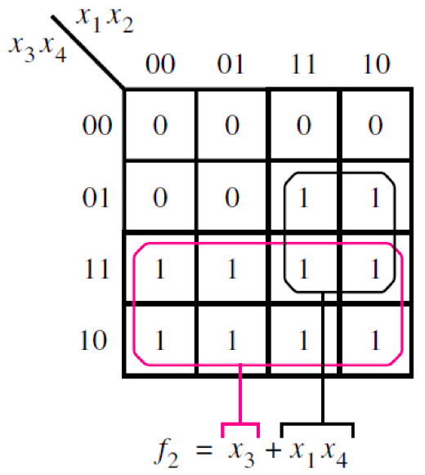
Example 5: four-variable Karnaugh map
Find the simplest SOP form of the following functions using a K-map:
f(x1, x2, x3, x4) = Σ m(2, 3, 6, 7, 9, 10, 11, 13, 14, 15)
Or
f(x1, x2, x3, x4)= Π M(0, 1, 4, 5, 8, 12)
[ Figure 2.54 from the textbook ]

Slide 91
Example 6: four-variable Karnaugh map
x₁ x₂
x₃ x₄
00 01 11 10
00
01
11
10
1 0 0 1
0 0 0 0
1 1 1 0
1 1 0 1
[ Figure 2.54 from the textbook ]

Slide 92
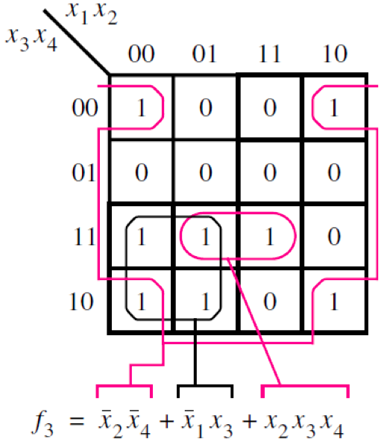
Example 6: four-variable Karnaugh map
[ Figure 2.54 from the textbook ]

Slide 93
Example 7: four-variable Karnaugh map
x₁ x₂
x₃ x₄
00 01 11 10
00
01
11
10
1 1 1 0
1 1 1 0
0 0 1 1
0 0 1 1
[ Figure 2.54 from the textbook ]

Slide 94
Example 7: four-variable Karnaugh map
x₁ x₂
x₃ x₄
00 01 11 10
00
01
11
10
1 1 1 0
1 1 1 0
0 0 1 1
0 0 1 1
[ Figure 2.54 from the textbook ]

Slide 95
Example 7: four-variable Karnaugh map
x₁ x₂
x₃ x₄
00 01 11 10
00
01
11
10
1 1 1 0
1 1 1 0
0 0 1 1
0 0 1 1
[ Figure 2.54 from the textbook ]

Slide 96
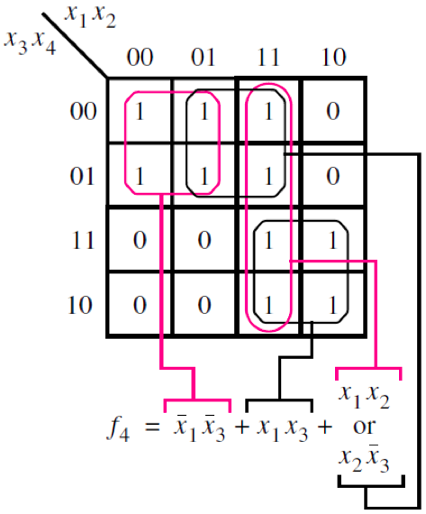
Example 7: four-variable Karnaugh map
[ Figure 2.54 from the textbook ]

Slide 97
Lec 9: Test Q1
Find the simplest SOP form of the following functions using a K-map:
f(y0, y1, y2) = Σ m(0, 2, 3, 4, 6, 7)
Or
f(y0, y1, y2) = Π M(1, 5)
y₀ y₁
y₂
00 01 11 10
0
1
[ Figure 2.52a from the textbook ]

Slide 98
Lec 9: Test Q1
Find the simplest SOP form of the following functions using a K-map:
f(y0, y1, y2) = Σ m(0, 2, 3, 4, 6, 7)
Or
f(y0, y1, y2) = Π M(1, 5)
y₀ y₁
y₂
00 01 11 10
0
1
1 | 1 | 1 | 1
0 | 1 | 1 | 0
[ Figure 2.52a from the textbook ]

Slide 99
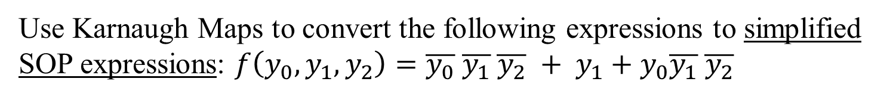
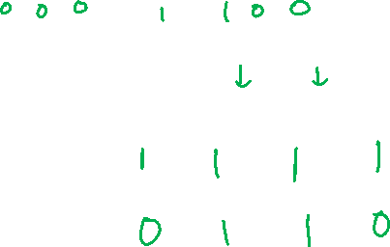
How to draw K-Map from the logic expression?
Use Karnaugh Maps to convert the following expressions to simplified SOP expressions: $f\left(y_{0},y_{1}, y_{2}\right)=\overline{y_{0}} \overline{y_{1}} \overline{y_{2}} + y_{1}+y_{0}\overline{y_{1}} \overline{y_{2}}$
y₀ y₁
y₂
00 01 11 10
0
1
[ Figure 2.52a from the textbook ]

Slide 100
Five-Variable K-Map

Slide 101
A five-variable Karnaugh map
[ Figure 2.55 from the textbook ]

Slide 102

END Slide

